Slide 1
Pamarthi radhika sri projects
The project is about learning and creating new things

Slide 2
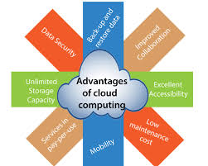

Clound computing and its benefits.

